Slide 1
To till or not to till That is the question
Team mEtillica
Regina Joie Enriquez

Slide 2



Regina Joie enriquez
Single mother of one
Ernesto
Determined to live life to the fullest. Life is an adventure. We have one chance to get the adventure right.
Hobbies:
Playing the guitar
Playing the piano
Reading

Slide 3
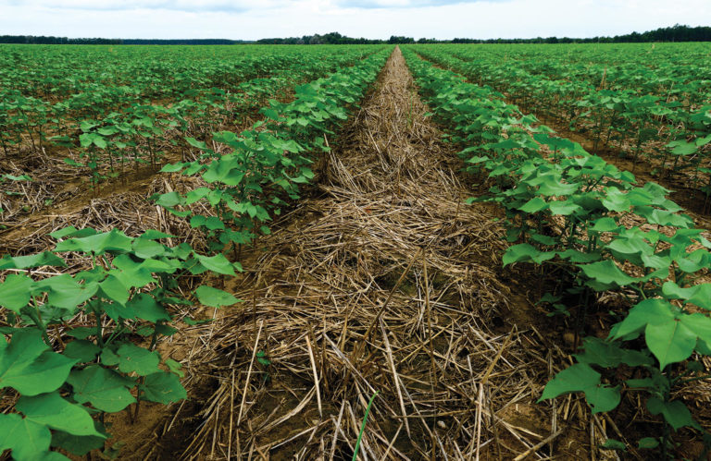
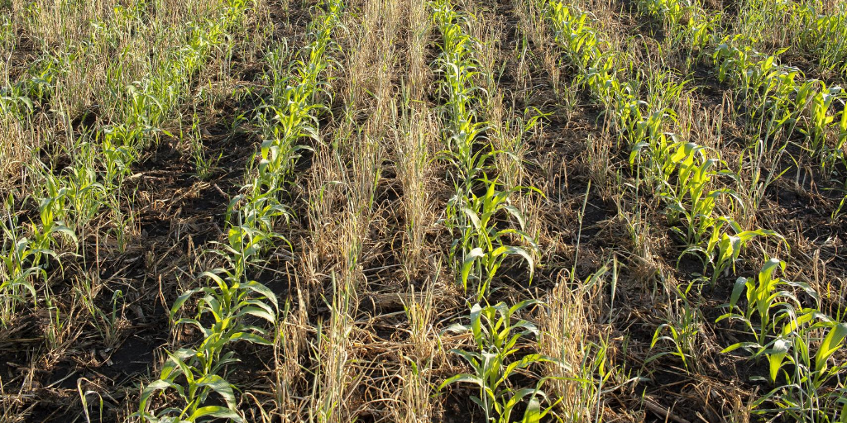
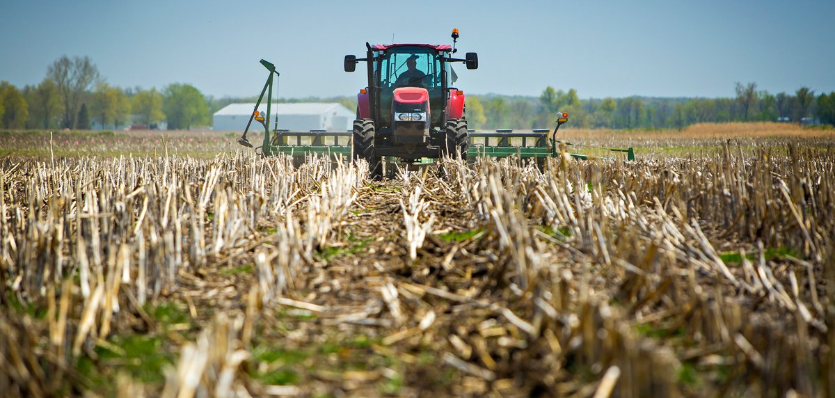
Team MeTILLica
Cover crop
No till
reduced till
Slows erosion, improves soil health, enhances water availability, increases biodiversity, and controls pests and disease
The minimization of soil disturbance that assist in keeping carbon in the soil and increase biodiversity
Soil disturbance is only in the top few inches, allowing for soil microbes to continue to diversify

Slide 4
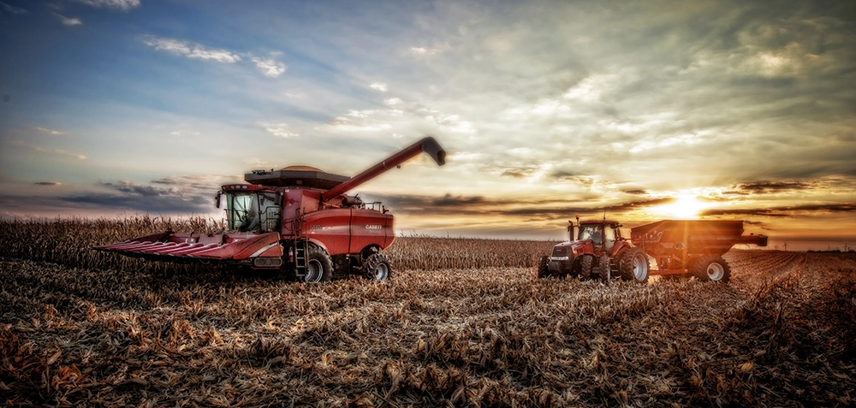
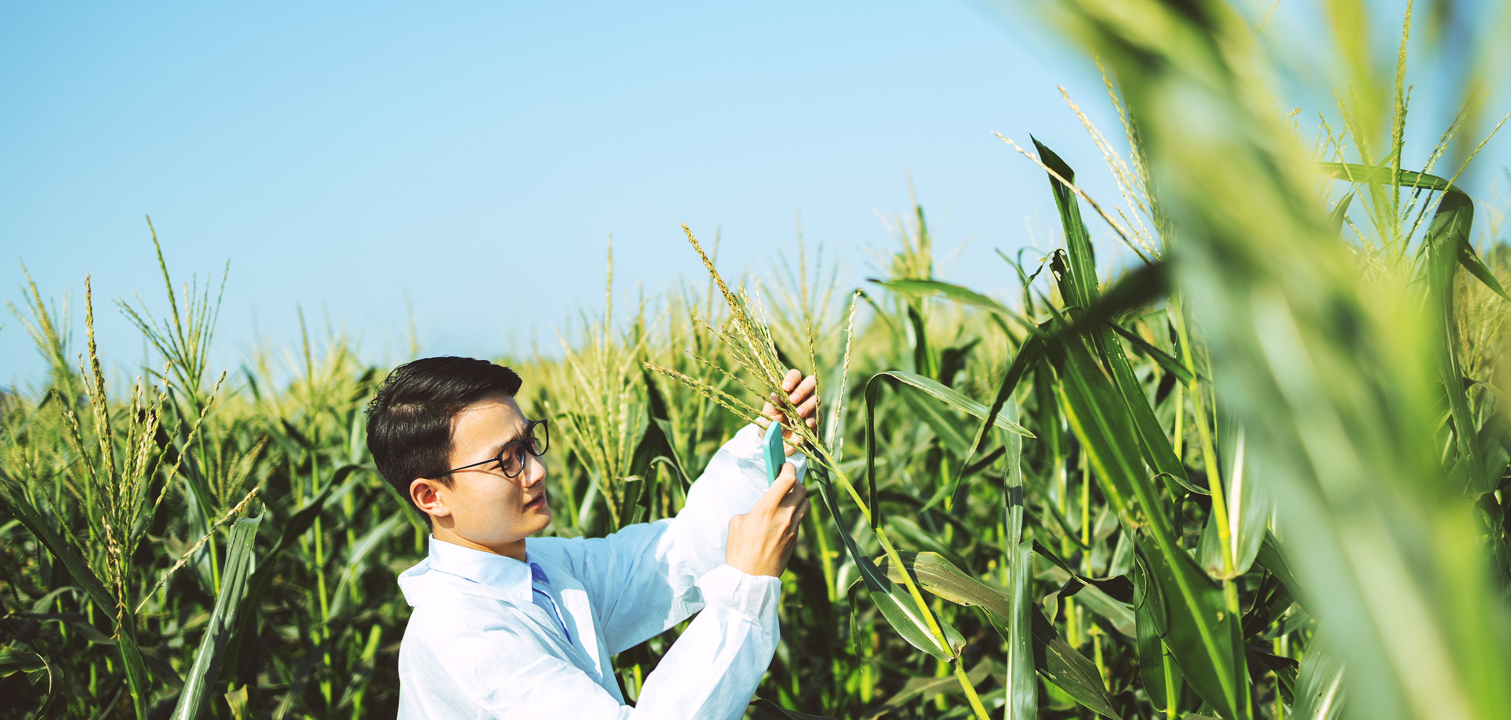
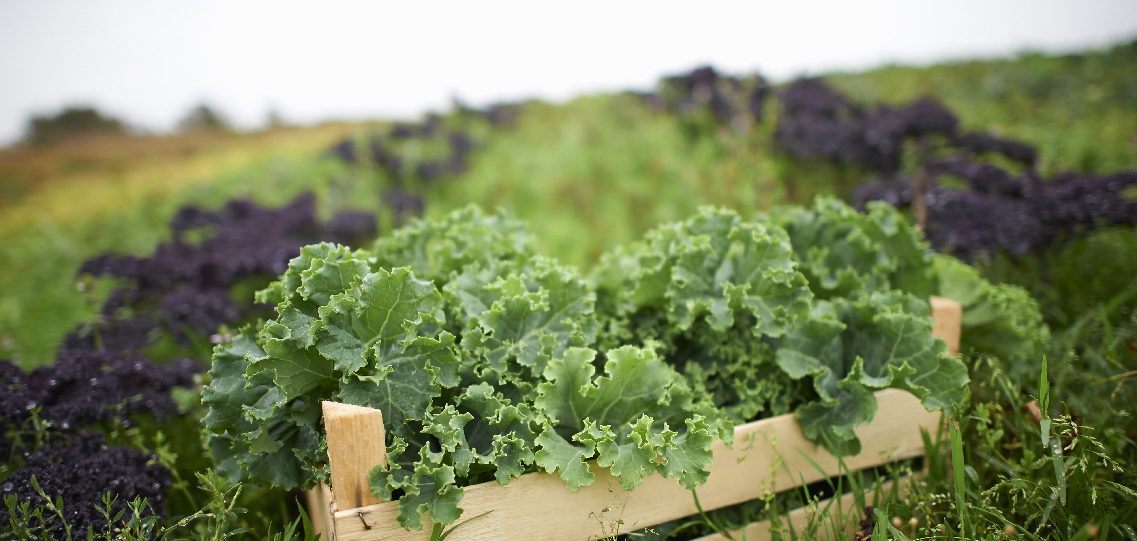
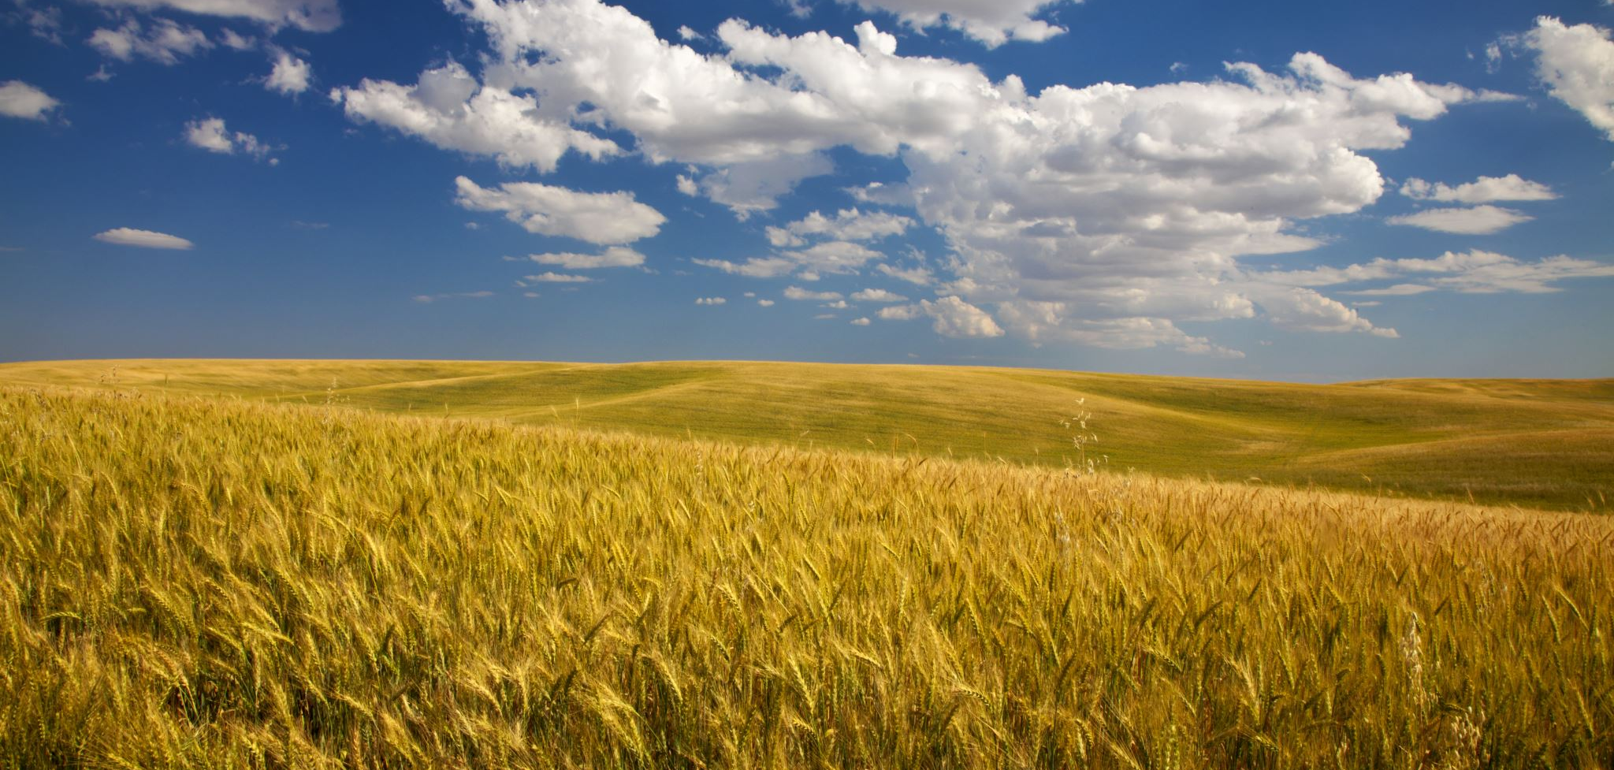
Project Background
Methods
findings
Summary
thoughts

Slide 5
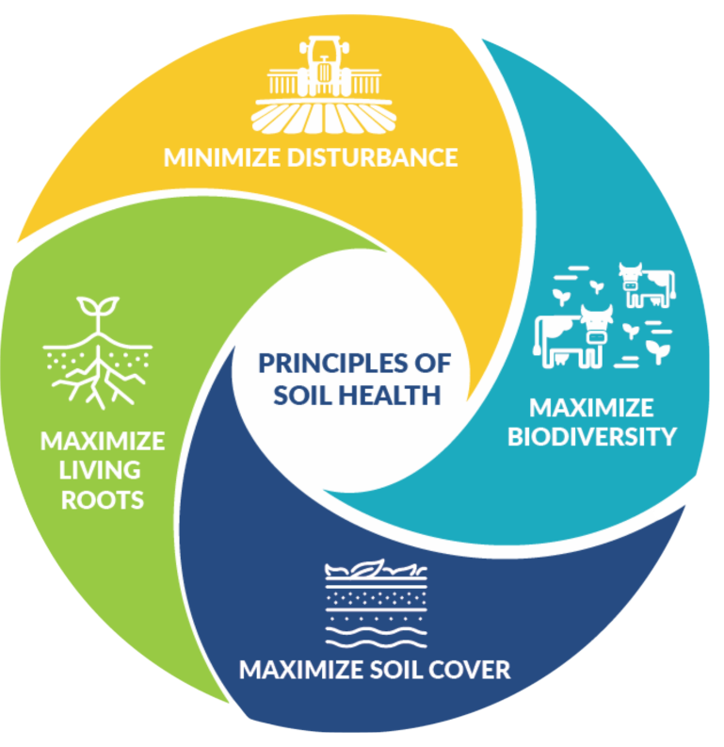
Project background
Innovative farming methods are being implemented to produce healthier crops
Soil health is vital in sustaining living ecosystems that support plants, animals, and humans
https://www.nrcs.usda.gov/wps/portal/nrcs/main/soils/health/

Slide 6
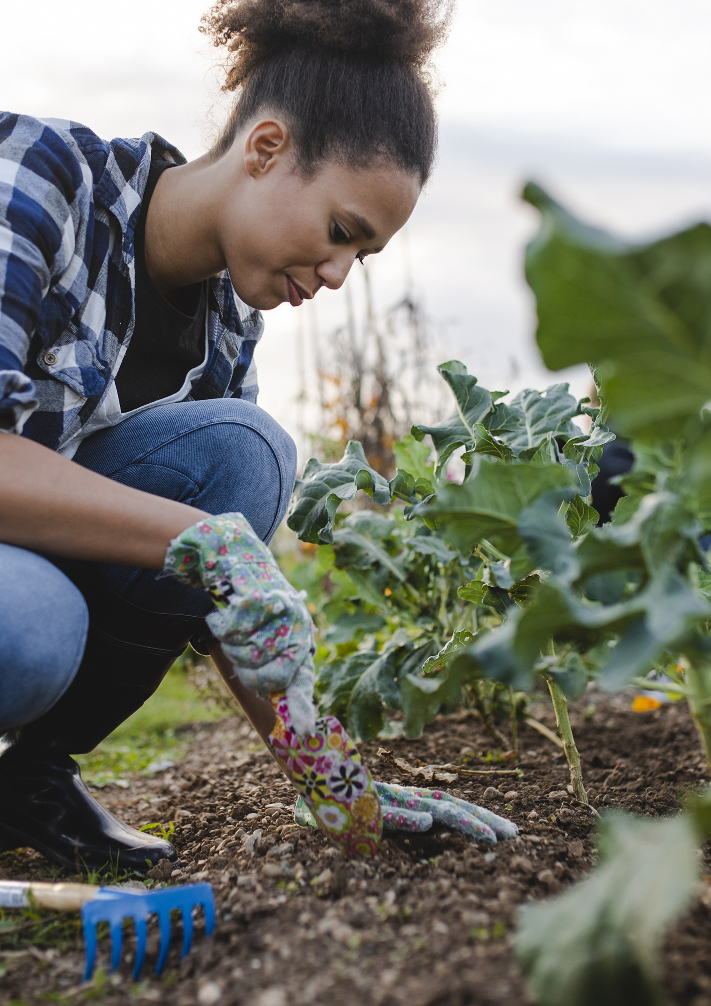
What is tilling?
Traditional practice in farming
Prepares the soil through agitation
Digging
Stirring
Overturning

Slide 7
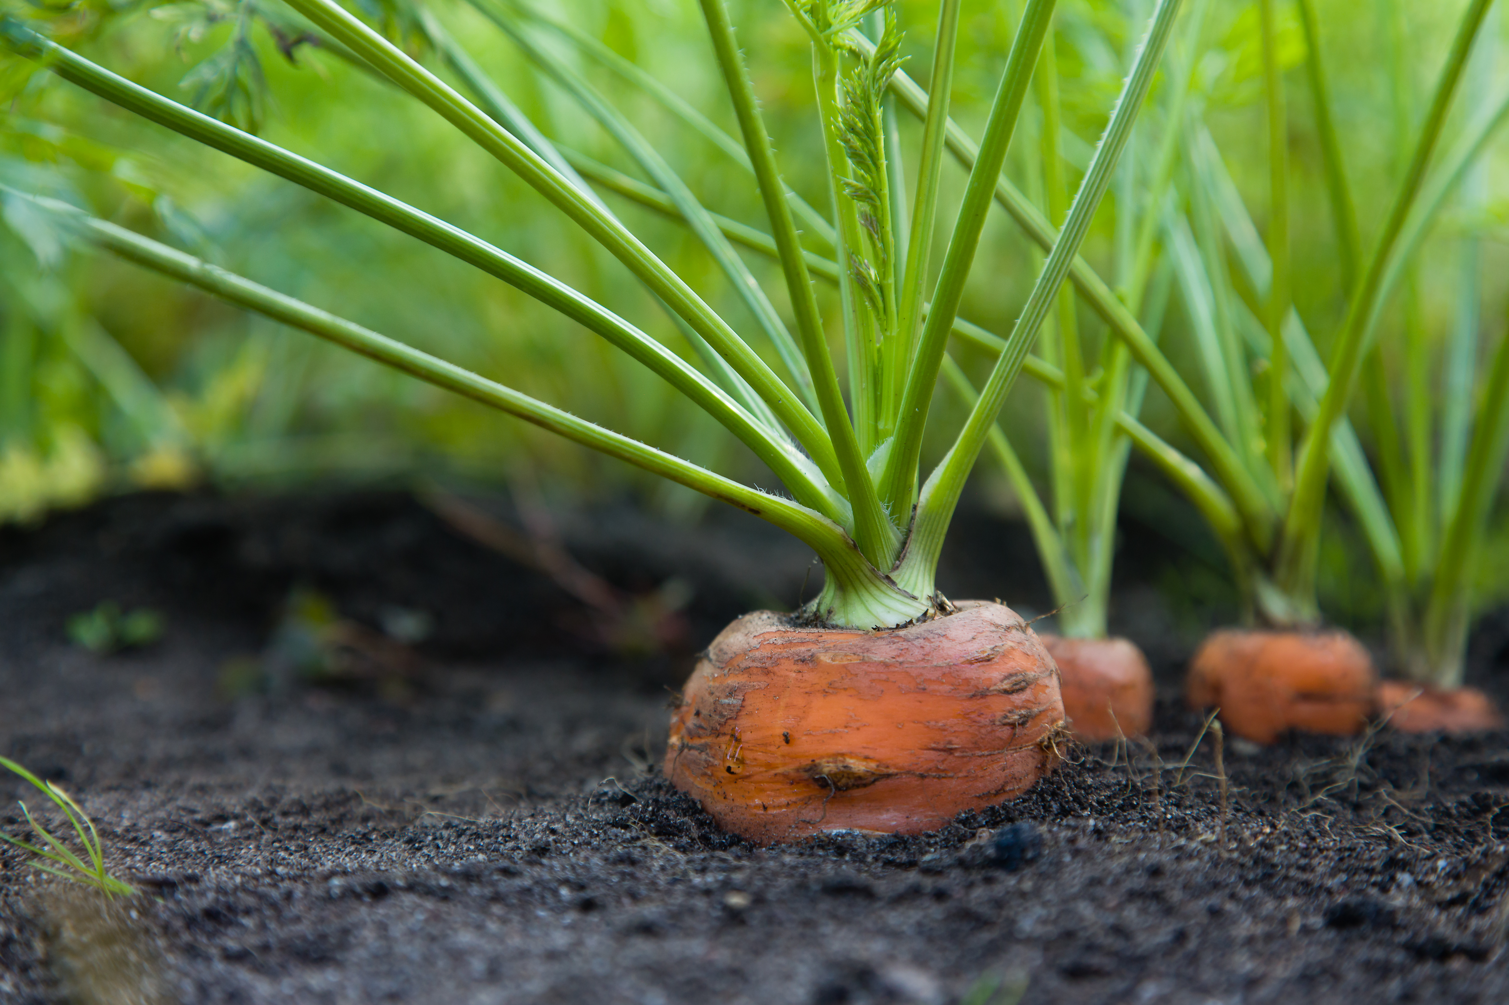
tilling
BENEFITS
Aerates the soil
Thought to enhance crop yields
Assists fertilizer and organic matter to soil sublayers
CONS
Dependency on fertilizer and chemicals such as pesticides.
Significant amounts of energy expended
Does not promote carbon sequestration

Slide 8
Traditional vs new
Is the traditional method of tilling required to continue to produce healthy yields of crop or are these new methods of farming more beneficial for healthier yields of crops?

Slide 9

methods
Searched open-source data source of USDA for soil data
Wrangled research data to focus on tilling, a farming technique
Focused data over a 10-year span
Developed a hypothesis for relationship between farming technique and crop production

Slide 10
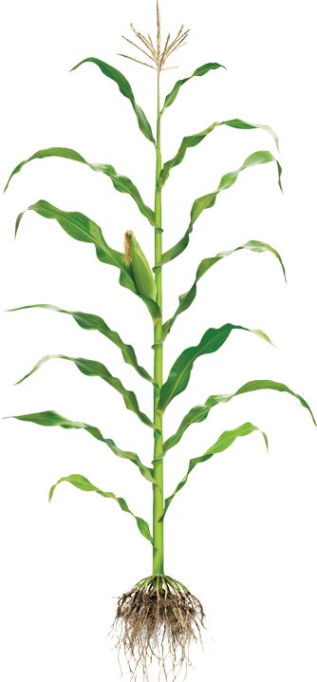
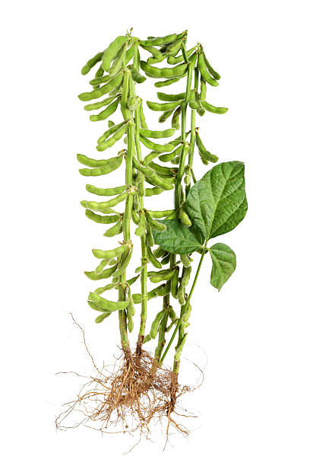
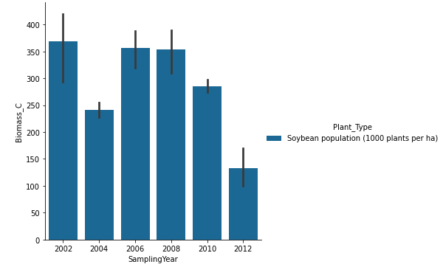
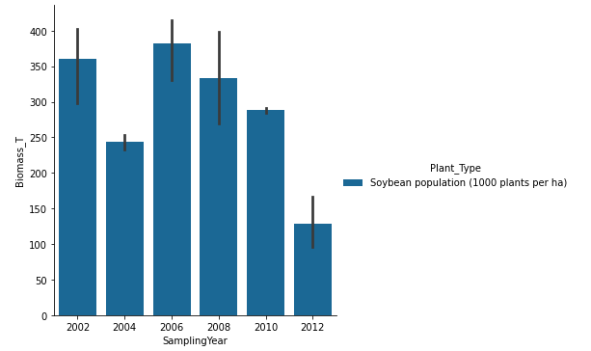
Comparing soybeans biomass yield: control vs treatment
Notes:
Referring to the original data set, it shows in 2012 there was a soil erosion causing the yield production to become significantly lower than its previous years.

Slide 11
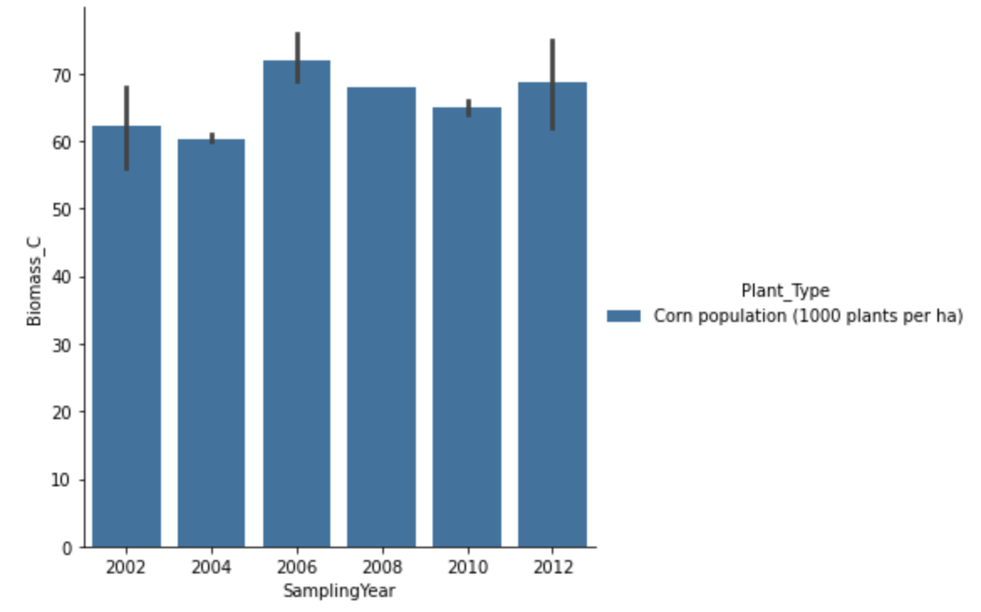
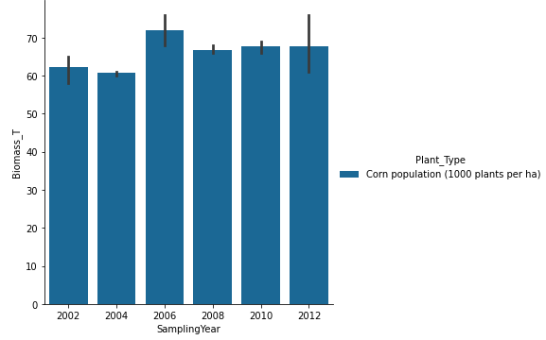
Comparing corn biomass yield: control vs treatment

Slide 12
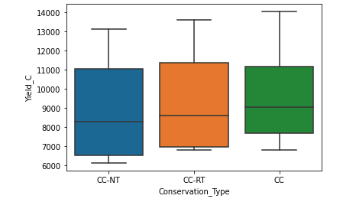
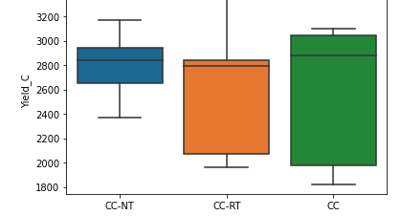
The different tilling methods and their yield production.
CORN
SOYBEAN

Slide 13
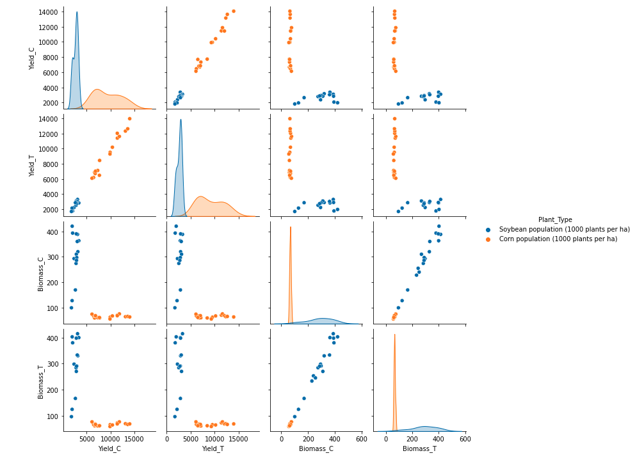
Corn vs. Soybean Yield
CORN VS SOYBEAN YIELD

Slide 14
corn
soybean

Slide 15

summary
Reduced tilling provides higher yield production after 7 years
Dirt still requires movement to assist in stimulation
Biodiversity
Enhanced water availability
Carbon sequestration

Slide 16

afterthoughts
Biodiverse soil will assist in the prevention of insect apocalypse
Regenerative farming that instills practices of reduced- and no-till farming is a technique that promotes harmony in nature and promotes the biodiversity that our planet needs. Everything is brought back to balance.

Slide 17

Future learning
Comparison of tilling practices to local microclimates
Soil drawdown and amount of carbon sequestration over time
Can soil health truly help reverse the impacts of climate change

Slide 18

Questions

